Slide 1
Section 7.2
Principals of Integral Evaluation: “Integration by Parts”

Slide 2
All graphics are attributed to:
Calculus,10/E by Howard Anton, Irl Bivens, and Stephen Davis
Copyright © 2009 by John Wiley & Sons, Inc. All rights reserved.

Slide 3
inTRODUCTION
  In this section we will discuss an integration technique that is essentially an antiderivative of the formula for differentiating a product of two functions.

Slide 4

The product rule and integration by parts
Since there is not a product rule for integration, we need to develop a general method for evaluating integrals of the form
If we start with the product rule and work backwards (integration), it will help identify a pattern.

Slide 5
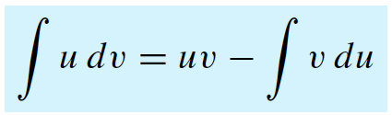
The product rule and integration by parts – con’t
This pattern produces the formula we use to make difficult integrations easier. We call the method integration by parts.

Slide 6



Example #1
The first step is to pick part of the expression x cos x to be u and another part to be dv (we will talk about strategies on a later slide).
For now, let u = x and let dv = cosx dx. Then (2nd step)
The 3rd step is to apply the integration by parts formula

Slide 7
Some Guidelines for choosing u and dv
The goal is to choose u and dv to obtain a new integral that is easier than the original.
The more you practice, the easier it is to pick u and dv correctly on your first try.
One suggestion is to pick a part of the expression to be u that gets “easier/simpler/smaller” when you take its derivative.
Another suggestion is to pick a part of the expression to be dv that you know how to integrate or that is easy to integrate.

Slide 8



Example #2
One choice is to let u=1 and dv = lnx dx .
If we did that, we would have to take the integral of lnx dx which we do not know how to do.
STEP 1: Therefore, we should let u=lnx since we know its derivative and let dv = dx.
STEP 2: That gives us
STEP 3: Apply the formula

Slide 9
Liate method
LIATE is an acronym for Logarithmic, Inverse trigonometric (which we have not done this year), Algebraic, Trigonometric, Exponential.
If you have to take the integral of the product of two functions from different categories in the list, you will often be more successful if you select u to be the function whose category occurs earlier in the list.
This method does not always work, but it works often enough to be a good rule of thumb.

Slide 10


Liate example
We could either make u = x (algebraic) or u = e^{x} (exponential). According to LIATE, since algebraic is earlier in the list, we should make u = x and dv = e^{x} dx. STEP 1
STEP 2: That give us
STEP 3: Apply the formula

Slide 11
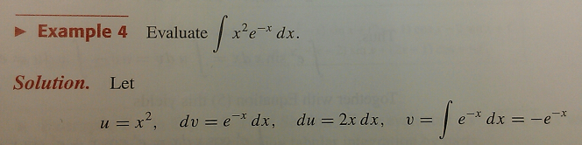
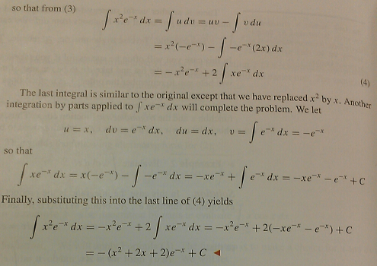
Repeated integration by parts
It is sometimes necessary to use integration by parts more than once in the same problem:
pg 494 in book
may be easier to read

Slide 12
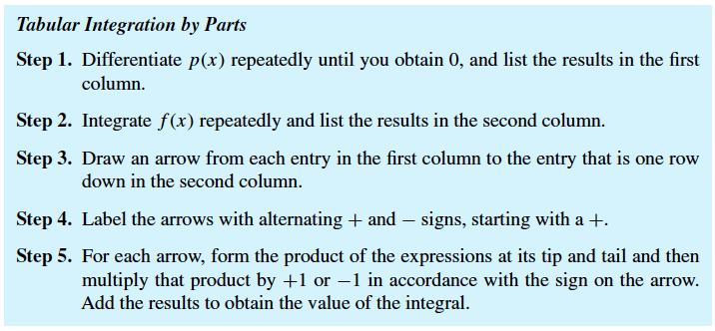
If you must do integration by parts more than twice, you may want to use a table

Slide 13
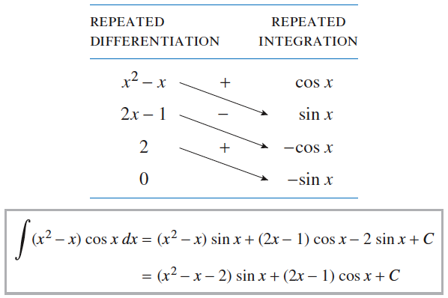
See pg 496 for example

Slide 14

Monet painting at the l’orangerie museum in paris, france

